Slide 1
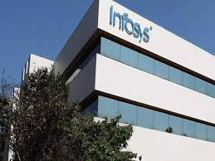

PRESENTATION
INFOSYS
PRESENTED BY:
RITIKA SINGH

Slide 2


TABLE OF CONTENTS
Introduction to Infosys
Infosys' Journey into AI and Deep Learning
Infosys Applied AI
Comparative Analysis of technology
with infosys
Applications of Deep Learning at Infosys
Challenges Faced
Future Directions
Conclusion

Slide 3
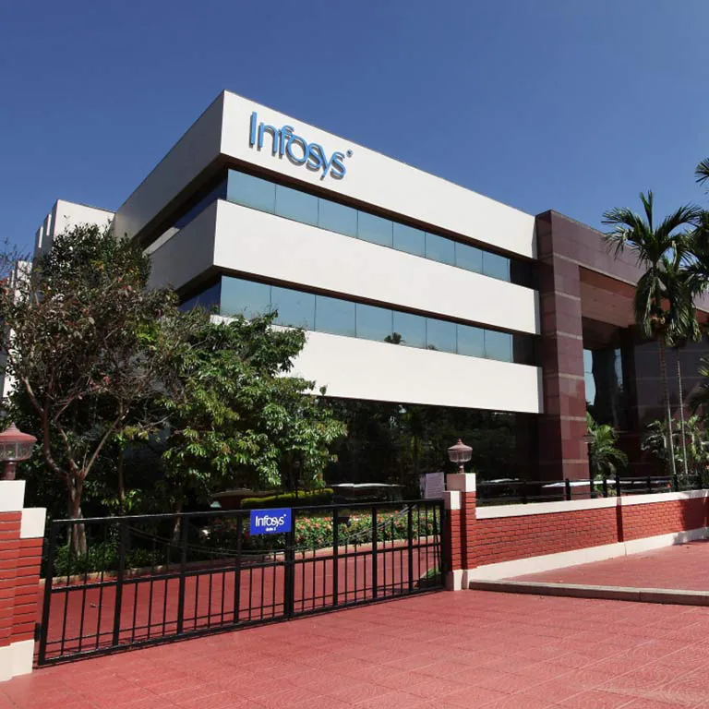

INTRODUCTION TO INFOSYS
Infosys is a global leader in technology consulting and services, recognized for its unwavering commitment to innovation, excellence, and ethical business practices. Founded in 1981 by N.R. Narayana Murthy and a group of visionary entrepreneurs, Infosys has grown to become one of India's most renowned multinational corporations, with a substantial global footprint.
The company is headquartered in Bangalore, India.

Slide 4
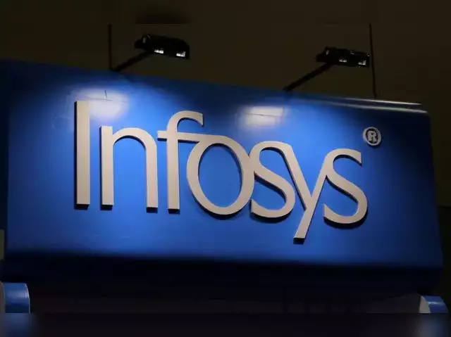
Infosys' Journey into AI and
Deep Learning
Infosys' journey into AI (Artificial Intelligence) and deep learning is marked by strategic commitment to staying at the forefront of technological
advancements. Here is an overview of how Infosys has ventured into the realm of AI and deep learning:
Early Recognition of the Potential: Infosys, being a global leader in IT services, recognized the transformative potential of AI and deep learning
early on.
Investment in Research and Development: To position itself as a leader in AI and deep learning, Infosys made substantial investments in research and
development.

Slide 5

Infosys' journey into AI and deep learning reflects a proactive and strategic approach to technological innovation. By investing in talent, research, collaboration, and the development of industry-specific solutions, Infosys has positioned itself as a key player in delivering AI-driven transformation for its clients.

Slide 6
INFOSYS APPLIED AI
Integrated AI offering for enterprises to discover, scale and future-proof AI-powered transformation for businesses.
Infosys Applied AI, part of Infosys Topaz, is an integrated offering converging the power of AI.
Infosys Applied AI helps enterprises uncover actionable insights from their own data estates, open source data and curated data exchanges on the cloud to build new AI models and use cases for the organization.

Slide 7
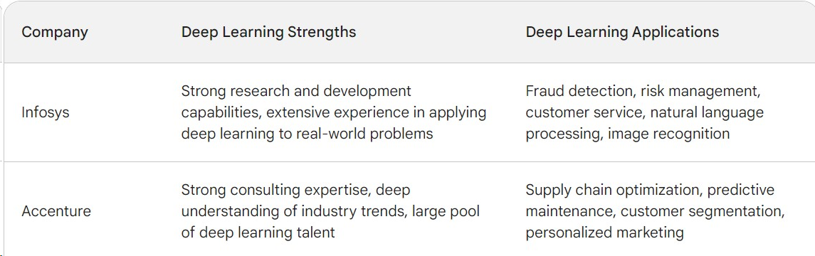

Comparitive Analysis of technology with infosys

Slide 8
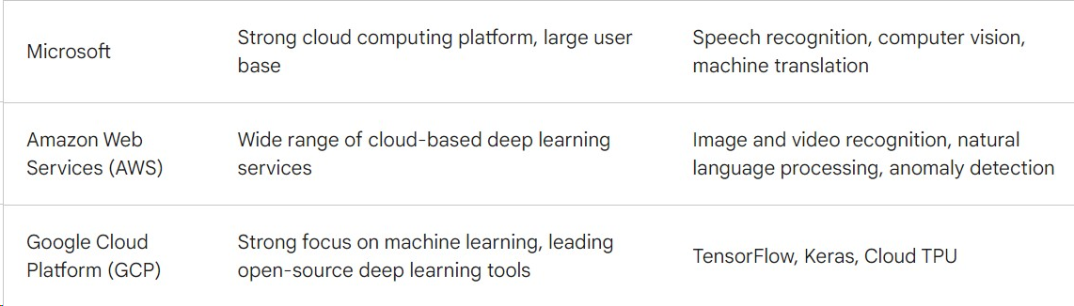

Slide 9

Applications of Deep Learning at Infosys
Predictive Maintenance in Manufacturings
Image and Video Analysis in Healthcare:
Problem: Analyzing medical images and videos for diagnosis is time consuming.
Solution: Infosys utilized deep learning algorithms for image and video analysis in healthcare. This included applications like medical image recognition, pathology detection, and even the analysis of medical videos for diagnostics
Problem: Unplanned downtime in manufacturing can be
costly.
Solution: Infosys implemented deep learning algorithms to
analyze data from
sensors on manufacturing equipment.

Slide 10
Supply Chain Optimization
Problem: Managing and optimizing complex supply chain networks.
Solution: Infosys applied deep learning models to analyze supply chain data, predict demand fluctuations, optimize inventory levels, and enhance overall supply chain efficiency.

Slide 11
BENEFITS AND IMPACT
1) Enhanced Operational Efficiency: The integration of deep
learning technologies at Infosys has led to enhanced operational efficiency across various domains.
2) Data Security and Fraud Prevention: Deep learning applications in cybersecurity and fraud detection contribute to strengthened data security. The ability to detect and prevent fraudulent activities in real-time enhances the overall integrity of business operations.

Slide 12
3) Innovation and Custom Solutions: Infosys' commitment to innovation in AI and deep learning allows the company to provide custom solutions tailored to the specific needs of its clients.
4) Increased Productivity: The automation of tasks through deep learning applications has increased overall productivity. Employees can focus on more strategic and creative aspects of their roles, while routine tasks are handled by automated systems.

Slide 13


FUTURE DIRECTIONS
Advancements in AI and Deep Learning Research.
Ethical AI and Responsible AI Practices.
Human-AI Collaboration and Augmentation.
Integration of Quantum Computing

Slide 14
THANK
YOU

